Slide 1
Homelessness and Hunger in New Jersey. What can United Methodist Church of Greater New Jersey do?

Slide 2
Homeless/Hunger in New Jersey
The governor of New Jersey, Phil Murphy, on May 9, 2019 recently singed a legislation to fight hunger in the state.
The towns with high concentration of homeless people are typically saddled with demographics that are below poverty line and struggling to their day to day living.
According to an NPR report, approximately 85% of the food that isn’t used in a typical American restaurant is thrown out

Slide 3
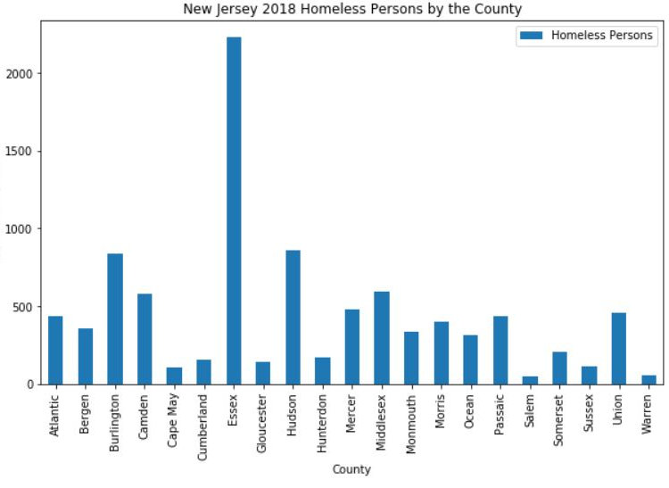
The New Jersey state wide report for homeless persons is scraped from : https://cdn.monarchhousing.org/wp-content/uploads/njcounts18/2018PITReportStatewide.pdf. And it shows that there 9303 homeless persons in New Jersey, with Essex County leading the way.

Slide 4
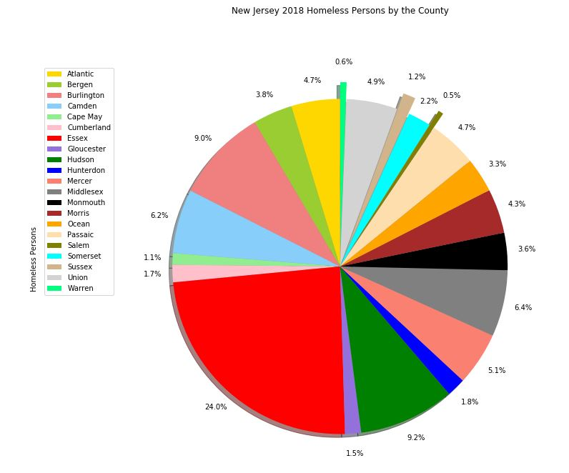
Essex County homeless accounts to 24% of the statewide count.

Slide 5
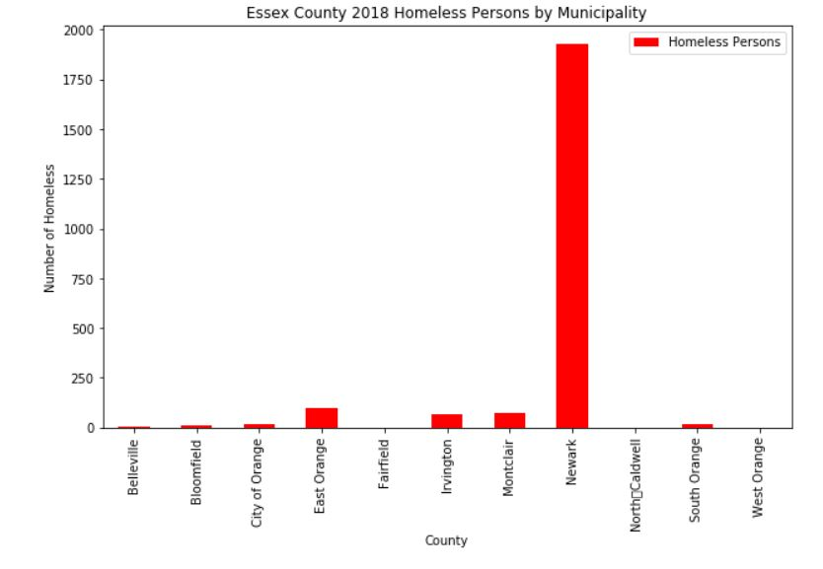
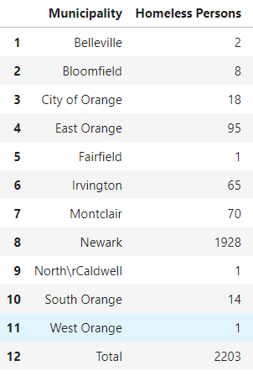
The Essex County wide report for homeless persons is scraped from : https://cdn.monarchhousing.org/wp-content/uploads/njcounts18/2018PITReportEssex.pdf. This report lists the homeless counts for each municipality in Essex Cunty. Not surprisingly it shows that the town of NEWARK has the most homeless persons with almost 2000 persons.

Slide 6
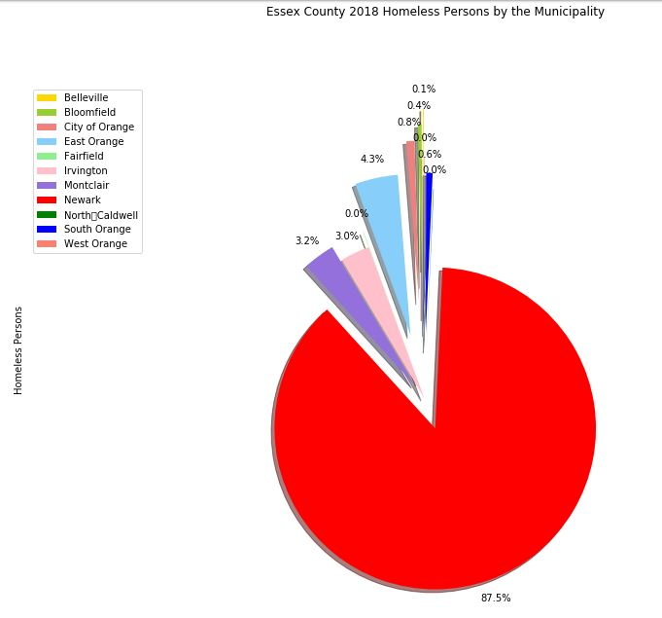
This accounts for 87.5% of the total Essex County count for homeless persons.

Slide 7
What can the UMCGNJ do?
The United Methodist Church of Greater New Jersey can charge their churches in Newark to establish Food Bank(s).
The UMCGNJ Newark churches will source out their food supply from food venues in within their proximities.

Slide 8
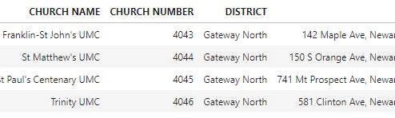
The UMCGNJ divided their presence in New Jersey into nine districts, the website list all the UMCGNJ churches the town and district where they belong. This data can be downloaded from their website, https://www.gnjumc.org/districts/. Scrapping the file shows that there are four churches in Newark.

Slide 9
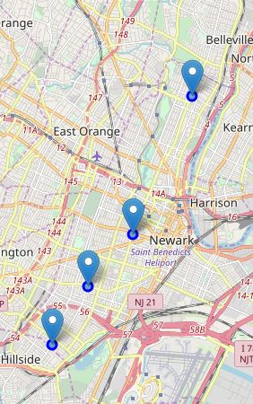
The map shows that the four UMCGNJ churches are spread out across Newark. Hence, they are strategically positioned as food banks stations.

Slide 10
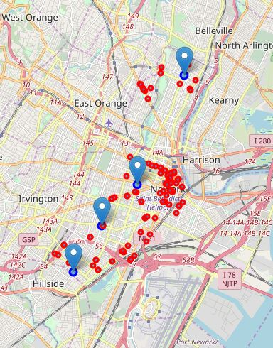
There are 105 venues that cater to food services around the neighborhoods of the churches. These venues can used as source for food supply for the proposed food banks.

Slide 11
To effective manage logistics required to collect, package, store, distribute the different types of food they collect. Different food types require different approach on logistics.
The food service venues need to be categorized (clustered) according to the food types they cater to.
Using k means clustering algorithm, its recommended that the venues be clustered into 5 venue categories :
Cluster 0 : Various Restaurants/BBQ Joints
Cluster 1 : Pizza Place
Cluster 2 : Coffee Shops
Cluster 3: Fast Food Places
Cluster 4: Deli

Slide 12
The list of venues clustered together :
 | CLUSTER | NAME | ADDRESS | CITY | CATEGORIES | CHURCH
1 | 0 | King's Family Restaurant | 327 Lyons Ave | Newark | Southern / Soul Food Restaurant | Franklin-St John's UMC
2 | 0 | Golden Krust Caribbean Bakery and Grill | 467 Lyons Ave | Newark | Caribbean Restaurant | Franklin-St John's UMC
3 | 0 | Amin's Fongyip Chinese Muslim | 430 Chancellor Ave | Newark | Chinese Restaurant | Franklin-St John's UMC
4 | 0 | La Cocina | 61 New St | Newark | Latin American Restaurant | St Matthew's UMC
5 | 0 | Green Chicpea | 59 Halsey St | Newark | Mediterranean Restaurant | St Matthew's UMC
6 | 0 | Steak and take food truck | Newark, NJ 07103 | Newark | Seafood Restaurant | St Matthew's UMC
7 | 0 | Chateau of Spain | 11 Franklin St | Newark | Spanish Restaurant | St Matthew's UMC
8 | 0 | Mi Gente Cafe | 7 Central Ave (Broad St) | Newark | Cuban Restaurant | St Matthew's UMC
9 | 0 | Dinosaur Bar-B-Que | 224 Market St (at Mulberry St) | Newark | BBQ Joint | St Matthew's UMC
10 | 0 | Vonda's Kitchen | 183 W Kinney St | Newark | American Restaurant | St Matthew's UMC
11 | 0 | Nizi Sushi | 28 Central Ave (Halsey St) | Newark | Sushi Restaurant | St Matthew's UMC
12 | 0 | The Halal Guys | 72 Halsey St | Newark | Halal Restaurant | St Matthew's UMC
13 | 0 | Delicias De Minas Restaurante | 168 McWhorter St | Newark | Brazilian Restaurant | St Matthew's UMC
14 | 0 | Dario's Restaurant | 20 Academy St | Newark | Mexican Restaurant | St Matthew's UMC
15 | 0 | Qdoba Mexican Grill | 64 Halsey St | Newark | Tex-Mex Restaurant | St Matthew's UMC
16 | 0 | McWhorter Barbeque | 104 McWhorter St (at Green St) | Newark | BBQ Joint | St Matthew's UMC
17 | 0 | Golden Krust Caribbean Bakery and Grill | 197 Market St (at Broad St.) | Newark | Caribbean Restaurant | St Matthew's UMC
18 | 0 | Chipotle Mexican Grill | 222 Market St (Market & Mulberry) | Newark | Mexican Restaurant | St Matthew's UMC
19 | 0 | Francessca's | Newark, NJ 07102 | Newark | Italian Restaurant | St Matthew's UMC
20 | 0 | Don Pepe Restaurant | 844 McCarter Hwy | Newark | Spanish Restaurant | St Matthew's UMC
21 | 0 | Spanish Tavern | 103 McWhorter St (at Green St) | Newark | Paella Restaurant | St Matthew's UMC
22 | 0 | 27 Mix | 27 Halsey St (Central Ave) | Newark | American Restaurant | St Matthew's UMC
23 | 0 | Harvest Table | 127 Halsey St (Raymond Blvd) | Newark | American Restaurant | St Matthew's UMC
24 | 0 | Nico | 1 Center St (Mulberry St) | Newark | Italian Restaurant | St Matthew's UMC
25 | 0 | Mulberry Restaurant and Pizzeria | 258 Mulberry St (at Elm St) | Newark | Italian Restaurant | St Matthew's UMC

Slide 13
26 | 0 | Just Fish Cafe | 57 William St (Washington) | Newark | Southern / Soul Food Restaurant | St Matthew's UMC
27 | 0 | Soul Food Chess House | 1075 Broad St (south st and lincoln park) | Newark | Southern / Soul Food Restaurant | St Matthew's UMC
28 | 0 | Maize Restaurant | 50 Park Pl | Newark | Seafood Restaurant | St Matthew's UMC
29 | 0 | Turkish Pita Place | 150 Halsey St | Newark | Middle Eastern Restaurant | St Matthew's UMC
30 | 0 | Ambassadors Fish & Chicken | 362 S Orange Ave | Newark | Restaurant | St Matthew's UMC
31 | 0 | Omar's Café | 646 Mount Prospect Ave | Newark | Cuban Restaurant | St Paul's Centenary UMC
32 | 0 | Bloomfield Avenue B.B.Q. | 391 Bloomfield Ave | Newark | Brazilian Restaurant | St Paul's Centenary UMC
33 | 0 | Spanish Manor Restaurant | 246 Heller Pkwy | Newark | Paella Restaurant | St Paul's Centenary UMC
34 | 0 | Taino's Kitchen | 849 Mount Prospect Ave | Newark | Spanish Restaurant | St Paul's Centenary UMC
35 | 0 | Stephanie's BBQ IV | 687 N 6th St (at Davenport Ave.) | Newark | BBQ Joint | St Paul's Centenary UMC
36 | 0 | Luigi's Restaurant | 561 Bloomfield Ave | Newark | Italian Restaurant | St Paul's Centenary UMC
37 | 0 | Kings Restaurant | 557 Clinton Ave | Newark | Restaurant | Trinity UMC
38 | 0 | King's Family Restaurant | 327 Lyons Ave | Newark | Southern / Soul Food Restaurant | Trinity UMC
39 | 0 | Vonda's Kitchen | 183 W Kinney St | Newark | American Restaurant | Trinity UMC
40 | 0 | Qdoba Mexican Grill | 10 Toler Pl (Space A6G - Terminal A) | Newark | Mexican Restaurant | Trinity UMC
41 | 0 | Golden Krust Caribbean Bakery and Grill | 467 Lyons Ave | Newark | Caribbean Restaurant | Trinity UMC
42 | 0 | Bergen Seafood | 1071 Bergen St (Lyons Ave) | Newark | Seafood Restaurant | Trinity UMC
43 | 0 | CPG Truck Company | Newark, NJ 07102 | Newark | Sushi Restaurant | Trinity UMC
44 | 0 | NA"JAYYAH | Newark, NJ | Newark | American Restaurant | Trinity UMC
45 | 1 | Domino's Pizza | 1003 Bergen St | Newark | Pizza Place | Franklin-St John's UMC
46 | 1 | Blaze Pizza | 691 Broad St, | Newark | Pizza Place | St Matthew's UMC
47 | 1 | Robert's Pizzeria | 63 New St (Washington Street) | Newark | Pizza Place | St Matthew's UMC
48 | 1 | Queen Pizza | 114 Halsey St | Newark | Pizza Place | St Matthew's UMC
49 | 1 | Giovanni Pizza, Pasta & Grill | 191 Central Ave | Newark | Pizza Place | St Matthew's UMC
50 | 1 | Pronto | 48 Academy St | Newark | Pizza Place | St Matthew's UMC

Slide 14
51 | 1 | Mercato Tomato Pie | 212 Market St | Newark | Pizza Place | St Matthew's UMC
52 | 1 | Pizza Hut | 250 Central Ave. | Newark | Pizza Place | St Matthew's UMC
53 | 1 | Gencarelli's Bar & Grill | 501 Bloomfield Ave (btwn N 10th & N 11th St.) | Newark | Pizza Place | St Paul's Centenary UMC
54 | 1 | Domino's Pizza | 551 Bloomfield Ave | Newark | Pizza Place | St Paul's Centenary UMC
55 | 1 | Papa John's Pizza | 451 Bloomfield Ave (Bloomfield Ave) | Newark | Pizza Place | St Paul's Centenary UMC
56 | 1 | Pizza Hut | 487 Bloomfield Ave. | Newark | Pizza Place | St Paul's Centenary UMC
57 | 1 | Domino's Pizza | 1003 Bergen St | Newark | Pizza Place | Trinity UMC
58 | 2 | Dunkin' | 10 Toler Pl, NEC Train Station (E Runyon St) | Newark | Coffee Shop | Franklin-St John's UMC
59 | 2 | Dunkin' | 257 Lyons Ave #259 | Newark | Coffee Shop | Franklin-St John's UMC
60 | 2 | Black Swan Espresso | 93 Halsey Street | Newark | Coffee Shop | St Matthew's UMC
61 | 2 | Dunkin' | 311 Springfield Ave, #313 (at Hunterdon St) | Newark | Coffee Shop | St Matthew's UMC
62 | 2 | Nubian Family Flavor | 410 Springfield Ave | Newark | Coffee Shop | St Matthew's UMC
63 | 2 | Intrinsic Cafe | 5 Sussex Ave (Central Ave) | Newark | Coffee Shop | St Matthew's UMC
64 | 2 | Dunkin' | 150 Halsey St (Academy) | Newark | Coffee Shop | St Matthew's UMC
65 | 2 | Mocha Town | 155 University Ave | Newark | Coffee Shop | St Matthew's UMC
66 | 2 | T.M. Ward Coffee Co. | 944 Broad St | Newark | Coffee Shop | St Matthew's UMC
67 | 2 | Broad Street Cafe | 562 Broad St | Newark | Coffee Shop | St Matthew's UMC
68 | 2 | Dunkin' | Central Ave | Newark | Coffee Shop | St Matthew's UMC
69 | 2 | Starbucks | 858 Broad St (Lafayette & Willam St) | Newark | Coffee Shop | St Matthew's UMC
70 | 2 | Starbucks | Paul Robeson Campus Ctr (at Rutgers Univ) | Newark | Coffee Shop | St Matthew's UMC
71 | 2 | Dunkin' | 188 Market St (Broad st) | Newark | Coffee Shop | St Matthew's UMC
72 | 2 | Dunkin' | 707 Broad St (Cedar St) | Newark | Coffee Shop | St Matthew's UMC
73 | 2 | Dunkin' | 746 Broadway #756 | Newark | Coffee Shop | St Paul's Centenary UMC
74 | 2 | Dunkin' | 880 Mount Prospect Ave (Montclair Ave) | Newark | Coffee Shop | St Paul's Centenary UMC
75 | 2 | Dunkin' | 895 Franklin Ave | Newark | Coffee Shop | St Paul's Centenary UMC

Slide 15
76 | 2 | Nubian Family Flavor | 410 Springfield Ave | Newark | Coffee Shop | Trinity UMC
77 | 2 | Dunkin' | 311 Springfield Ave, #313 (at Hunterdon St) | Newark | Coffee Shop | Trinity UMC
78 | 2 | Dunkin' | 226 Elizabeth Ave #232 | Newark | Coffee Shop | Trinity UMC
79 | 2 | Dunkin' | 10 Toler Pl, NEC Train Station (E Runyon St) | Newark | Coffee Shop | Trinity UMC
80 | 2 | Dunkin' | 10 Toler Pl | Newark | Coffee Shop | Trinity UMC
81 | 2 | Dunkin' | 335 McCarter Hwy | Newark | Coffee Shop | Trinity UMC
82 | 2 | Dunkin' | 257 Lyons Ave #259 | Newark | Coffee Shop | Trinity UMC
83 | 3 | Wendy's | 462 Chancellor Ave | Newark | Fast Food Restaurant | Franklin-St John's UMC
84 | 3 | McDonald's | 872 Frelinghuysen Ave | Newark | Fast Food Restaurant | Franklin-St John's UMC
85 | 3 | Ambassador Fish and Chicken | 139 Clinton Ave | Newark | Fast Food Restaurant | St Matthew's UMC
86 | 3 | Wendy's | 427 Springfield Avenue | Newark | Fast Food Restaurant | St Matthew's UMC
87 | 3 | White Castle | 642-654 Broadway | Newark | Fast Food Restaurant | St Paul's Centenary UMC
88 | 3 | McDonald's | 621 Broadway | Newark | Fast Food Restaurant | St Paul's Centenary UMC
89 | 3 | White Castle | 307 Elizabeth Ave | Newark | Fast Food Restaurant | Trinity UMC
90 | 3 | Wendy's | 427 Springfield Avenue | Newark | Fast Food Restaurant | Trinity UMC
91 | 3 | Ambassador Fish and Chicken | 139 Clinton Ave | Newark | Fast Food Restaurant | Trinity UMC
92 | 3 | Burger King & Popeyes | Elizabeth Place (East Peddie St) | Newark | Fast Food Restaurant | Trinity UMC
93 | 3 | SONIC Drive In | 189-237 Springfield Ave (Irvine Turner) | Newark | Fast Food Restaurant | Trinity UMC
94 | 3 | Popeyes Louisiana Kitchen | Newark, NJ 07103 | Newark | Fast Food Restaurant | Trinity UMC
95 | 3 | Jersey Fried Chicken | 289 Elizabeth Ave | Newark | Fast Food Restaurant | Trinity UMC
96 | 3 | McDonald's | 101-115 Clinton Ave | Newark | Fast Food Restaurant | Trinity UMC
97 | 3 | McDonald's | 872 Frelinghuysen Ave | Newark | Fast Food Restaurant | Trinity UMC
98 | 3 | Burger King | 10 Toler Pl | Newark | Fast Food Restaurant | Trinity UMC
99 | 4 | Bragman's Deli | 393 Hawthorne Ave | Newark | Deli | Franklin-St John's UMC
100 | 4 | Hobby's Delicatessen | 32 Branford Pl (at Halsey St) | Newark | Deli | St Matthew's UMC
101 | 4 | Halsey Deli | 147 Halsey St (Acadamey Street) | Newark | Deli | St Matthew's UMC
102 | 4 | Margarita's Deli | 432 Central Ave | Newark | Deli | St Matthew's UMC
103 | 4 | Hanna's Deli | 14 E Park St (btwn Park Pl & Mulberry St) | Newark | Deli | St Matthew's UMC
104 | 4 | Bragman's Deli | 393 Hawthorne Ave | Newark | Deli | Trinity UMC
105 | 4 | Ademis Grocery | 146 Sherman Ave (Vanderpool Street) | Newark | Deli | Trinity UMC

Slide 16
Depending on their resources available, the churches can either collectively collect the foods from each cluster, i.e. the churches pool their resources and establish team(s) for each cluster.
Or each church can collect the foods from the venues in their neighborhood according to the cluster type.

